Slide 1


The PiXL Club The PiXL Club The PiXL Club The PiXL Club The PiXL Club The PiXL Club The PiXL Club The PiXL Club The PiXL Club The PiXL Club The PiXL Club The PiXL Club The PiXL Club The PiXL Club The PiXL Club The PiXL Club The PiXL Club The PiXL Club The PiXL Club The PiXL Club The PiXL Club The PiXL Club The PiXL Club The PiXL Club The PiXL Club The PiXL Club The PiXL Club The PiXL Club The PiXL Club The PiXL Club The PiXL Club The PiXL Club The PiXL Club The PiXL Club The PiXL Club The PiXL Club The PiXL Club The PiXL Club The PiXL Club The PiXL Club The PiXL Club The PiXL Club The PiXL Club The PiXL Club The PiXL Club XL Club The PiXL Club The PiXL Club The PiXL Club The PiXL Club The PiXL Club The PiXL Club The PiXL Club The PiXL Club The PiXL Club The PiXL Club The PiXL Club The PiXL Club The PiXL Club The PiXL Club The PiXL Club The PiXL Club The PiXL Club The PiXL Club The PiXL Club The PiXL Club The PiXL Club The PiXL Club The PiXL Club The PiXL Club The PiXL Club The PiXL Club The PiXL Club The PiXL Club The PiXL Club The PiXL Club The PiXL Club The PiXL Club The PiXL Club The PiXL Club The PiXL Club The PiXL Club The PiXL Club The PiXL Club The PiXL Club The PiXL Club The PiXL Club The PiXL Club The PiXL Club The PiXL Club The PiXL Club The PiXL Club The PiXL Club The PiXL Club The PiXL Club The PiXL Club The PiXL Club The PiXL Club The PiXL Club The PiXL Club The PiXL Club The PiXL Club The PiXL Club The PiXL Club The PiXL Club The PiXL Club The PiXL Club The PiXL Club The PiXL Club The PiXL Club The PiXL Club The PiXL Club The PiXL Club The PiXL Club The PiXL Club The PiXL Club The PiXL Club The PiXL Club The PiXL Club The PiXL Club The PiXL Club The PiXL Club The PiXL Club The PiXL Club The PiXL Club The PiXL Club The PiXL Club The PiXL Club The PiXL Club The PiXL Club The PiXL Club The PiXL Club The PiXL Club The PiXL Club The PiXL Club The PiXL Club The PiXL Club The PiXL Club The PiXL Club The PiXL Club The PiXL Club The PiXL Club The PiXL Club The PiXL Club The PiXL Club The PiXL Club The PiXL Club The PiXL Club The PiXL Club The PiXL Club The PiXL Club The PiXL Club The PiXL Club The PiXL Club The PiXL Club The PiXL Club The PiXL Club The PiXL Club The PiXL Club The PiXL Club The PiXL Club The PiXL Club The PiXL Club The PiXL Club The PiXL Club The PiXL Club The PiXL Club The PiXL Club The PiXL Club The PiXL Club The PiXL Club The PiXL Club The PiXL Club The PiXL Club The PiXL Club The PiXL Club The PiXL Club The PiXL Club The PiXL Club The PiXL Club The PiXL Club The PiXL Club The PiXL Club The PiXL Club The PiXL Club The PiXL Club The PiXL Club The PiXL Club The PiXL Club The PiXL Club The PiXL Club The PiXL Club The PiXL Club The PiXL Club The PiXL Club The PiXL Club The PiXL Club The PiXL Club The PiXL Club The PiXL Club The PiXL Club The PiXL Club The PiXL Club The PiXL Club The PiXL Club The PiXL Club The PiXL Club The PiXL Club The PiXL Club The PiXL Club The PiXL Club The PiXL Club The PiXL Club The PiXL Club The PiXL Club The PiXL Club The PiXL Club The PiXL Club The PiXL Club The PiXL Club The PiXL Club The PiXL Club The PiXL Club The PiXL Club The PiXL Club The PiXL Club The PiXL Club The PiXL Club The PiXL Club The PiXL Club The PiXL Club The PiXL Club The PiXL Club The PiXL Club The PiXL Club The PiXL Club The PiXL Club The PiXL Club The PiXL Club The PiXL Club The PiXL Club The PiXL Club The PiXL Club The PiXL Club The PiXL Club The PiXL Club The PiXL Club The PiXL Club The PiXL Club The PiXL Club The PiXL Club The PiXL Club The PiXL Club The PiXL Club The PiXL Club The PiXL Club The PiXL Club The PiXL Club The PiXL Club The PiXL Club The PiXL Club The PiXL Club The PiXL Club The PiXL Club The PiXL Club The PiXL Club The PiXL Club The PiXL Club The PiXL Club The PiXL Club The PiXL Club The PiXL Club The PiXL Club The PiXL Club The PiXL Club The PiXL Club The PiXL Club The PiXL Club The PiXL Club The PiXL Club The PiXL Club The PiXL Club The PiXL Club The PiXL Club The PiXL Club The PiXL Club The PiXL Club The PiXL Club The PiXL Club The PiXL Club The PiXL Club The PiXL Club The PiXL Club The PiXL Club The PiXL Club The PiXL Club The PiXL Club The PiXL Club The PiXL Club The PiXL Club The PiXL Club The PiXL Club The PiXL Club The PiXL Club The PiXL Club The PiXL Club The PiXL Club The PiXL Club The PiXL Club The PiXL Club The PiXL Club The PiXL Club The PiXL Club The PiXL Club The PiXL Club The PiXL Club The PiXL Club The PiXL Club The PiXL Club The PiXL Club The PiXL Club The PiXL Club The PiXL Club The PiXL Club The PiXL Club The PiXL Club The PiXL Club The PiXL Club The PiXL Club The PiXL Club The PiXL Club The PiXL Club The PiXL Club The PiXL Club The PiXL Club The PiXL Club The PiXL Club The PiXL Club The PiXL Club The PiXL Club The PiXL Club The PiXL Club The PiXL Club The PiXL Club The PiXL Club The PiXL Club The PiXL Club The PiXL Club The PiXL Club The PiXL Club The PiXL Club The PiXL Club The PiXL Club The PiXL Club The PiXL Club The PiXL Club The PiXL Club The PiXL Club The PiXL Club The PiXL Club The PiXL Club The PiXL Club The PiXL Club The PiXL Club The PiXL Club The PiXL Club The PiXL Club The PiXL Club The PiXL Club The PiXL Club The PiXL Club The PiXL Club The PiXL Club The PiXL Club The PiXL Club The PiXL Club The PiXL Club The PiXL Club The PiXL Club The PiXL Club The PiXL Club The PiXL Club The PiXL Club The PiXL Club The PiXL Club The PiXL Club The PiXL Club The PiXL Club The PiXL Club The PiXL Club The PiXL Club The PiXL Club The PiXL Club The PiXL Club The PiXL Club The PiXL Club The PiXL Club The PiXL Club The PiXL Club The PiXL Club The PiXL Club The PiXL Club The PiXL Club The PiXL Club The PiXL Club The PiXL Club The PiXL Club The PiXL Club The PiXL Club The PiXL Club The PiXL Club The PiXL Club The PiXL Club The PiXL Club The PiXL Club The PiXL Club The PiXL Club The PiXL Club The PiXL Club The PiXL Club The PiXL Club The PiXL Club The PiXL Club The PiXL Club The PiXL Club The PiXL Club The PiXL Club The PiXL Club The PiXL Club The PiXL Club The PiXL Club The PiXL Club The PiXL Club The PiXL Club The PiXL Club The PiXL Club The PiXL Club The PiXL Club The PiXL Club The PiXL Club The PiXL Club The PiXL Club The PiXL Club The PiXL Club The PiXL Club The PiXL Club The PiXL Club The PiXL Club The PiXL Club The PiXL Club The PiXL Club The PiXL Club The PiXL Club The PiXL Club The PiXL Club The PiXL Club The PiXL Club The PiXL Club The PiXL Club The PiXL Club The PiXL Club The PiXL Club The PiXL Club The PiXL Club The PiXL Club The PiXL Club The PiXL Club The PiXL Club The PiXL Club The PiXL Club The PiXL Club The PiXL Club The PiXL Club The PiXL Club The PiXL Club The PiXL Club The PiXL Club The PiXL Club The PiXL Club The PiXL Club The PiXL Club The PiXL Club The PiXL Club The PiXL Club The PiXL Club The PiXL Club The PiXL Club The PiXL Club The PiXL Club The PiXL Club The PiXL Club The PiXL Club The PiXL Club The PiXL Club The PiXL Club The PiXL Club The PiXL Club The PiXL Club The PiXL Club The PiXL Club The PiXL Club The PiXL Club The PiXL Club The PiXL Club The PiXL Club The PiXL Club The PiXL Club The PiXL Club The PiXL Club The PiXL Club The PiXL Club The PiXL Club The PiXL Club The PiXL Club The PiXL Club The PiXL Club The PiXL Club The PiXL Club The PiXL Club The PiXL Club The PiXL Club The PiXL Club The PiXL Club The PiXL Club The PiXL Club The PiXL Club The PiXL Club The PiXL Club The PiXL Club The PiXL Club The PiXL Club The PiXL Club The PiXL Club The PiXL Club The PiXL Club The PiXL Club The PiXL Club The PiXL Club The PiXL Club The PiXL Club The PiXL Club The PiXL Club The PiXL Club The PiXL Club The PiXL Club The PiXL Club The PiXL Club The PiXL Club The PiXL Club The PiXL Club The PiXL Club The PiXL Club The PiXL Club The PiXL Club The PiXL Club The PiXL Club The PiXL Club The PiXL Club The PiXL Club The PiXL Club The PiXL Club The PiXL Club The PiXL Club The PiXL Club The PiXL Club The PiXL Club The PiXL Club The PiXL Club The PiXL Club The PiXL Club The PiXL Club The PiXL Club The PiXL Club The PiXL Club The PiXL Club The PiXL Club The PiXL Club The PiXL Club The PiXL Club The PiXL Club The PiXL Club The PiXL Club The PiXL Club The PiXL Club The PiXL Club The PiXL Club The PiXL Club The PiXL Club The PiXL Club The PiXL Club The PiXL Club The PiXL Club The PiXL Club The PiXL Club The PiXL Club The PiXL Club The PiXL Club The PiXL Club The PiXL Club The PiXL Club The PiXL Club The PiXL Club The PiXL Club The PiXL Club The PiXL Club The PiXL Club The PiXL Club The PiXL Club The PiXL Club The PiXL Club The PiXL Club The PiXL Club The PiXL Club The PiXL Club The PiXL Club The PiXL Club The PiXL Club The PiXL Club The PiXL Club The PiXL Club The PiXL Club The PiXL Club The PiXL Club The PiXL Club The PiXL Club The PiXL Club The PiXL Club The PiXL Club The PiXL Club The PiXL Club The PiXL Club The PiXL Club The PiXL Club The PiXL Club The PiXL Club The PiXL Club The PiXL Club The PiXL Club The PiXL Club The PiXL Club The PiXL Club The PiXL Club The PiXL Club The PiXL Club The PiXL Club The PiXL Club The PiXL Club The PiXL Club The PiXL Club The PiXL Club The PiXL Club The PiXL Club The PiXL Club The PiXL Club The PiXL Club The PiXL Club The PiXL Club The PiXL Club The PiXL Club The PiXL Club The PiXL Club The PiXL Club The PiXL Club The PiXL Club The PiXL Club The PiXL Club The PiXL Club The PiXL Club The PiXL Club The PiXL Club The PiXL Club The PiXL Club The PiXL Club The PiXL Club The PiXL Club The PiXL Club The PiXL Club The PiXL Club The PiXL Club The PiXL Club The PiXL Club The PiXL Club The PiXL Club The PiXL Club The PiXL Club The PiXL Club The PiXL Club The PiXL Club The PiXL Club The PiXL Club The PiXL Club The PiXL Club The PiXL Club The PiXL Club The PiXL Club The PiXL Club The PiXL Club The PiXL Club The PiXL Club The PiXL Club The PiXL Club The PiXL Club The PiXL Club The PiXL Club The PiXL Club The PiXL Club The PiXL Club The PiXL Club The PiXL Club The PiXL Club The PiXL Club The PiXL Club The PiXL Club The PiXL Club The PiXL Club The PiXL Club The PiXL Club The PiXL Club The PiXL Club The PiXL Club The PiXL Club The PiXL Club The PiXL Club The PiXL Club The PiXL Club The PiXL Club The PiXL Club The PiXL Club The PiXL Club The PiXL Club The PiXL Club The PiXL Club The PiXL Club The PiXL Club The PiXL Club The PiXL Club The PiXL Club The PiXL Club The PiXL Club The PiXL Club The PiXL Club The PiXL Club The PiXL Club The PiXL Club The PiXL Club The PiXL Club
PiXL KnowIT!
GCSE Chemistry
Edexcel Topic – Separate Chemistry 1
© Copyright The PiXL Club Ltd, 2017
This resource is strictly for the use of member schools for as long as they remain members of The PiXL Club. It may not be copied, sold nor transferred to a third party or used by the school after membership ceases. Until such time it may be freely used within the member school.
All opinions and contributions are those of the authors. The contents of this resource are not connected with nor endorsed by any other company, organisation or institution.
www.pixl.org.uk The PiXL Club Ltd, Company number 07321607

Slide 2
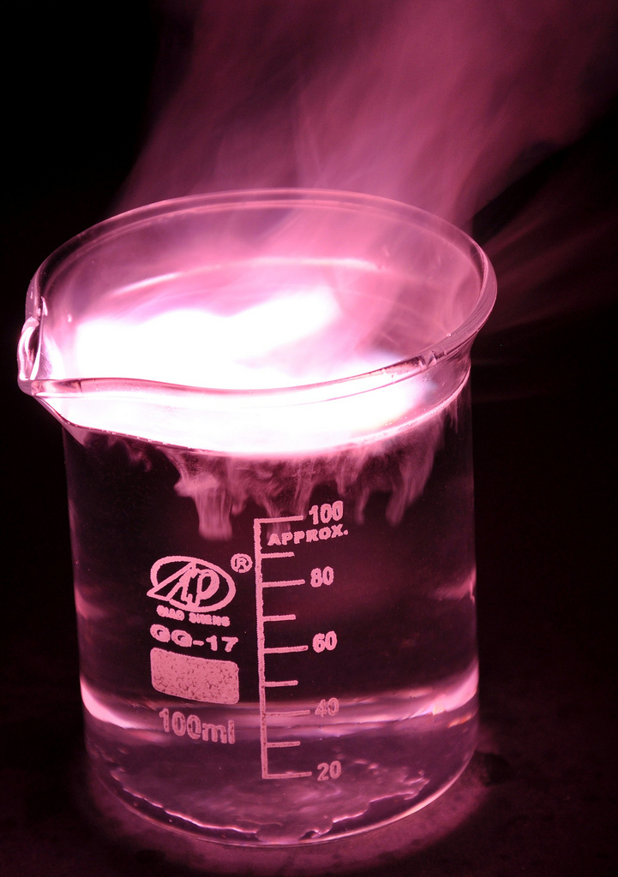
Overview Separate Chemistry 1
Transition metals, alloys and corrosion
Transition metals
Corrosion
Alloys
Quantitative analysis
Titrations and unknown concentration (HT)
Percentage yield
Atom economy
Molar volume of gas (HT)
Dynamic equilibria
Haber Process
Factors affecting equilibrium (HT)
Fertilisers
Chemical cells and fuel cells
Chemical cells
Hydrogen-oxygen fuel cell
Notes:
https://c2.staticflickr.com/4/3178/4076380768_03994aed44_b.jpg

Slide 3

LearnIT!
KnowIT!
Transition metals,
alloys and corrosion
Transition metals
Corrosion
Alloys

Slide 4
Transition metals
THE TRANSITION METALS
Most metals are transition metals.
The transition metals are located between Group 2 and Group 3.
The transition metals have:
High melting points
High densities
Coloured compounds
Catalytic activity
1
2
3
4
5
6
7
0
H
He
Li
Be
B
C
N
O
F
Ne
Na
Mg
Al
Si
P
S
Cl
Ar
K
Ca
Sc
Ti
V
Cr
Mn
Fe
Co
Ni
Cu
Zn
Ga
Ge
As
Se
Br
Kr
Rb
Sr
Y
Zr
Nb
Mo
Tc
Ru
Rh
Pd
Ag
Cd
In
Sn
Sb
Te
I
Xe
Cs
Ba
La
Hf
Ta
W
Re
Os
Ir
Pt
Au
Hg
Tl
Pb
Bi
Po
At
Rn
Fr
Ra
Ac
Rf
Db
Sg
Bh
Hs
Mt
?
?
?
E.g. Iron
Melting point: 1,538 ºC
Density: 7.874 g/cm³
Coloured compounds: Iron (II) compounds are green; iron (III) compounds are orange/ brown
Catalyst: Making ammonia in the Haber process

Slide 5

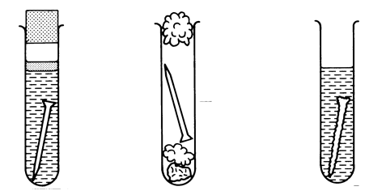
Corrosion and its prevention
Oxidation of metals (addition of oxygen) results in corrosion.
Rusting is an example of corrosion. Both oxygen and water are necessary for iron to rust. Excluding oxygen and/or water can prevent corrosion.
iron + water + oxygen → hydrated iron (III) oxide
No water
Anhydrous CaCl₂
No oxygen
Boiled water and oil
AIR and WATER
Normal water

Slide 6
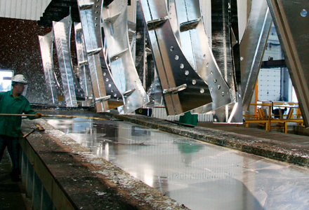
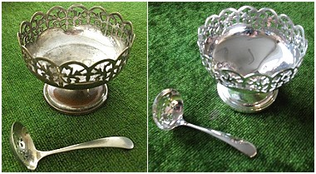
Corrosion and its prevention
Corrosion can be prevented by applying a coating that acts as a barrier, such as electroplating or sacrificial protection.
In this factory the metal is being coated in zinc to provide sacrificial protection.
The zinc is more reactive than the iron, so zinc oxide will be produced in preference to iron oxide, thus protecting the iron from corrosion.
Electroplating can also be used to improve the appearance of an object, e.g. electroplating a spoon with silver.

Slide 7
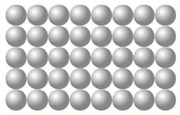
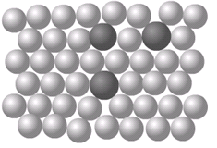
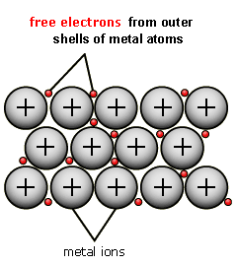
Alloys
The giant structure of atoms with strong metallic bonding gives most metals a high melting and boiling point.
Metals are malleable (can be hammered into shape) and ductile (can be drawn out into a wire) because the layers of atoms (or ions) in a giant metallic structure can slide over each other.
Delocalised electrons in metals enable electricity and heat to pass through the metal easily.
A metal mixed with other elements is called an alloy. Alloys are harder than pure metals. Alloys are made from two or more different metals.
Pure metal Alloy
The different sized atoms of the metals distort the layers in the structure, making it more difficult for them to slide over each other, and so make the alloys harder than pure metals.
For example, gold is naturally soft but adding copper makes jewellery stronger and last longer.

Slide 8

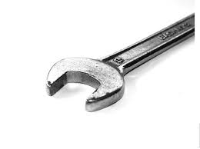
Alloys as useful materials
Steels are alloys of iron that contain specific amounts of carbon and other metals.
High carbon steel is strong but brittle.
Low carbon steel is softer and more easily shaped.
Stainless steels containing chromium and nickel are hard and resistant to corrosion.

Slide 9
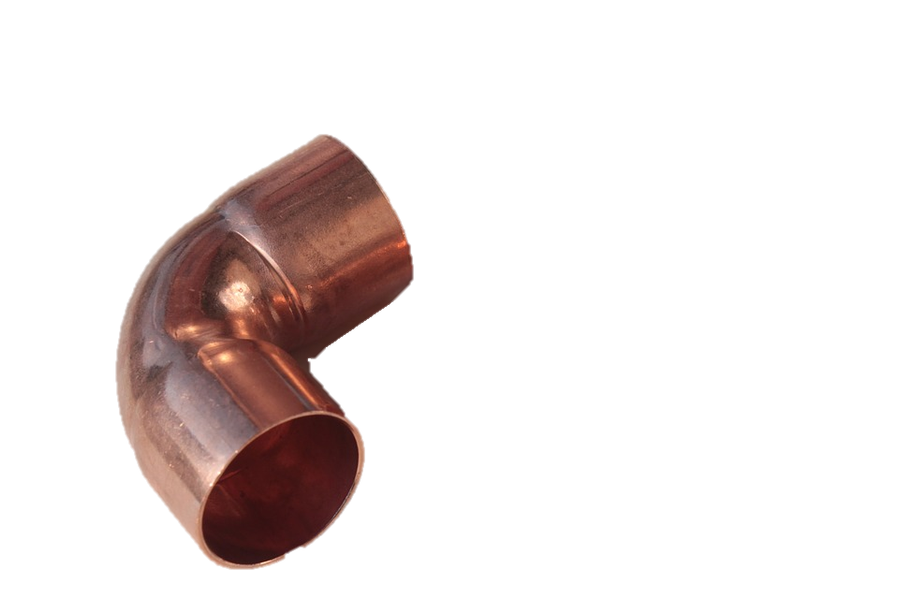
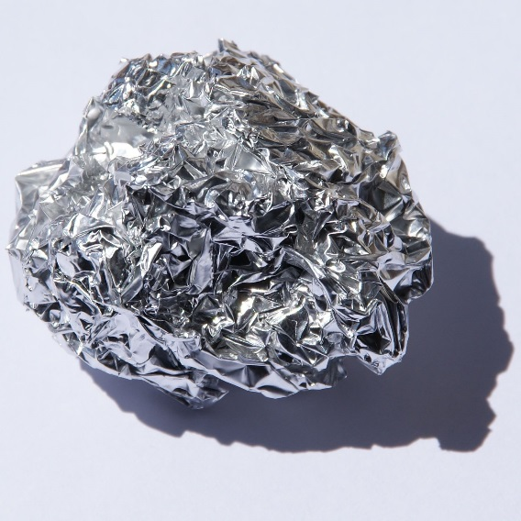
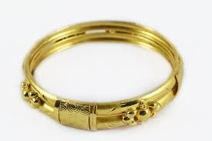
Metals as useful materials
Aluminium | Copper | Gold
Low density and low levels of corrosion so used in the production of aircraft and cars. | High electrical conductivity so used in electrical wiring. | Malleable and shiny appearance make it perfect for jewellery.

Slide 10
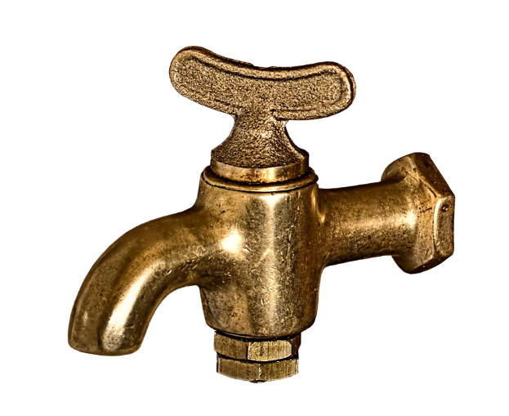
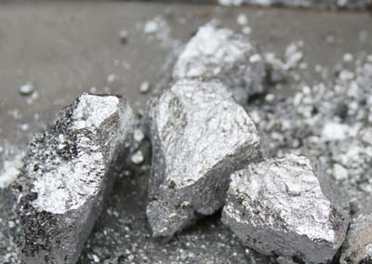
Alloys as useful materials
Magnalium | Brass
Alloy of aluminium with magnesium; and small amounts of nickel and tin. With smaller amounts of magnesium – increased strength, corrosion resistance and lower density than pure aluminium. Used in aircraft and car parts. With larger amounts of magnesium – brittle and more susceptible to corrosion – used in pyrotechnics. | Alloys of copper and zinc. Used in decoration as a gold substitute. For low friction jobs such as gears, locks and doorknobs.

Slide 11

QuestionIT!
Transition metals, alloys and corrosion
Transition metals
Corrosion
Alloys

Slide 12
Transition metals, alloys and corrosion– QuestionIT
Where are most metals found in the periodic table?
Name four properties of transition metals.
What is corrosion?
Name three ways to prevent the rusting of iron.
What is electroplating? What is it used for?

Slide 13
Transition metals, alloys and corrosion– QuestionIT
What is an alloy?
How does converting a metal to an alloy improve the strength?
What is magnalium?
Name two uses of magnalium.
How is iron turned into steel?

Slide 14

AnswerIT!
Transition metals, alloys and corrosion
Transition metals
Corrosion
Alloys

Slide 15
Transition metals, alloys and corrosion– QuestionIT
Where are most metals found in the periodic table?
Transition metals between Groups 2 and 3
Name four properties of transition metals.
High melting point, high density, form coloured compounds, act as catalysts.
What is corrosion?
Oxidation of metals.
Name three ways to prevent the rusting of iron.
Exclusion of oxygen, exclusion of water, sacrificial protection.
What is electroplating? What is it used for?
Using electricity to oat a metal with a thin layer of another metal.

Slide 16
Transition metals, alloys and corrosion– QuestionIT
What is an alloy?
Metal mixed with other elements.
How does converting a metal to an alloy improve the strength?
Distorts the layers in the structure making it difficult for them to slide over each other.
What is magnalium?
Alloy of aluminium and magnesium.
Name two uses of magnalium.
Aircraft/ car parts, pyrotechnics.
How is iron turned into steel?
Addition of carbon and other substances e.g. chromium.

Slide 17
LearnIT!
KnowIT!
Quantitative
Analysis – Part 1
Titrations and unknown concentrations (HT)

Slide 18
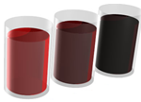
Calculating concentration
Chemists quote the amount of substance (solute) dissolved in a certain volume of the solution. The units used to express the concentration can be grams per decimetre cubed (g/dm³). A decimetre (1dm ³) cubed is equal to 1000cm³.
The blackcurrant juice is getting more concentrated – the darker colour indicates more squash is in the same volume of its solution
If you know the mass of the solute dissolved in a certain volume of solution, you can work out the concentration using:
Concentration = amount of solute (g)
(g/dm³ ) Volume of solution (dm³)
Remember if you are using cm³ , to multiply the volume by 1000 to covert to dm³
Example:
50g of sodium hydroxide is dissolved in water to make up 200cm³ .
What is the concentration in dm³?
50g/200cm³= 0.25g/cm³
0.25g/cm³ x 1000 = 250g/dm³

Slide 19
Calculating concentration
Chemists can measure concentration in moles per cubic decimetre (mol/dm³).
Concentration = amount (mol)
(mol/dm³) volume (dm³)
Example 1:
Example 2:
What is the concentration of a solution that has 35.0g of solute in 0.5dm³of solution?
35/0.5 = 70 g/dm³
Calculate the mass of magnesium chloride (MgCl₂) if there is 1 dm³ of a 1mol/ dm³ solution.
Mass of 1 mole of magnesium chloride
= 24 + (35.5 × 2) = 95 g So there are 95 g of magnesium chloride in
1 dm³ of a 1 mol/dm³ solution.
To convert between the two units for concentration:
mol/dm³ x relative molecular mass = g/dm³

Slide 20
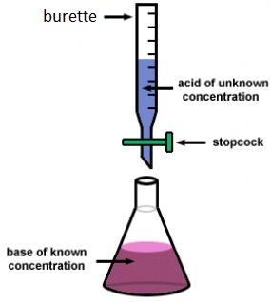
Titration calculations
If the volumes of two solutions that react completely are known and the concentration of one solution is known, the concentration of the other solution can be calculated.
2NaOH(aq) + H₂SO₄(aq)→ Na₂S0₄(aq) + 2H₂O(l)
It takes 12.20cm³ of sulfuric acid to neutralise 24.00cm³ of sodium hydroxide solution, which has a concentration of 0.50mol/dm³.
Calculate the concentration of the sulfuric acid in g/dm³
0.5 mol/dm³ x (24/1000) dm³ = 0.012 mol of NaOH
The equation shows that 2 mol of NaOH reacts with 1 mol of H₂SO₄, so the number of moles in 12.20cm³ of sulfuric acid is (0.012/2) = 0.006 mol of sulfuric acid
Calculate the concentration of sulfuric acid in mol/ dm³
0.006 mol x (1000/12.2) dm³ =0.49mol/dm³
Calculate the concentration of sulfuric acid in g/ dm³
H₂SO₄ = (2x1) + 32 + (4x16) = 98g
0.49 x 98g = 48.2g/dm³

Slide 21
QuestionIT!
Quantitative
Analysis – Part 1
Titrations and unknown concentrations (HT)

Slide 22
Quantitative analysis part 1 (HT)– QuestionIT
What units can be used for the concentration of a solution?
What does dm³ mean?
Give the equation for calculating concentration from the mass of substance and volume of solution.
What is the equation for the calculation of concentration from the moles and volume of solution?

Slide 23
Quantitative analysis part 1 – QuestionIT
Calculate the concentration in g/dm³ for 50g of sodium chloride in 2.5 dm³ of water.
Calculate the concentration in g/dm³ of 1.4g of potassium carbonate in 855cm³ of water.
A teacher has a solution of lithium fluoride with a concentration of 72.6g/dm³. Calculate the mass of lithium fluoride dissolved in 25.0cm³ of solution.

Slide 24
Quantitative analysis part 1– QuestionIT
What is the concentration, in g/ dm³, of a solution that has 40g of solute in 2dm³ of solution?
Calculate the concentration in mol/dm³ of a solution that has
0.75 mol of an acid in 3dm³ of solution.
It takes 28.0cm³ of potassium hydroxide to neutralise 25.00cm³ of nitric acid at a concentration of 0.50 mol/dm³.
HNO₃ + KOH → KNO₃ + H₂O
Calculate the concentration of the potassium hydroxide.

Slide 25
AnswerIT!
Quantitative
Analysis – Part 1
Titrations and unknown
Concentrations (HT)

Slide 26
Quantitative analysis part 1– QuestionIT
What units can be used for the concentration of a solution?
g/dm³ mol/dm³
What does dm³ mean?
1000cm³
Give the equation for calculating concentration from the mass of substance and volume of solution.
Concentration = mass ÷ volume
What is the equation for the calculation of concentration from the moles and volume of solution?
Concentration = moles ÷ volume

Slide 27
Quantitative analysis part 1– QuestionIT
Calculate the concentration in g/dm³ for 50g of sodium chloride in 2.5 dm³ of water.
50/2.5 = 20 g/dm³
Calculate the concentration in g/dm³ of 1.4g of potassium carbonate in 855cm³ of water.
(1.4/855) x 1000 = 1.64 g/dm³
A teacher has a solution of lithium fluoride with a concentration of 72.6g/dm³. Calculate the mass of lithium fluoride dissolved in 25.0cm³ of solution.
25cm³ = 0.025dm³
72.6 x 0.025 = 1.8g

Slide 28
Use of amount of substance – QuestionIT
What is the concentration, in g/ dm³, of a solution that has 40g of solute in 2dm³ of solution?
Concentration = mass ÷ volume = 40 g ÷ 2 dm³ = 20 g/dm³
Calculate the concentration in mol/dm³ of a solution that has
0.75 mol of an acid in 3dm³ of solution.
0.75 mol/3 dm³ = 0.25 mol/dm³

Slide 29
Quantitative analysis part 1– QuestionIT
It takes 28.0cm³ of potassium hydroxide to neutralise 25.00cm³ of nitric acid at a concentration of 0.50 mol/dm³.
HNO₃ + KOH → KNO₃ + H₂O
Calculate the concentration of the potassium hydroxide.
Number of moles of nitric acid = concentration × volume
= 0.5 mol/dm³ × (25 ÷ 1000) dm³ = 0.0125 mol The equation for the reaction shows that 1 mole of potassium
hydroxide reacts with 1 mole of nitric acid. So there is 0.0125
mol of KOH in 28 cm³ of solution. So the concentration of KOH in mol/dm³ = number of moles ÷
volume = 0.0125 mol ÷ (28 ÷ 1000) dm³ = 0.45 mol/dm³

Slide 30
LearnIT!
KnowIT!
Quantitative
Analysis – Part 2
Percentage yield
Atomy economy

Slide 31
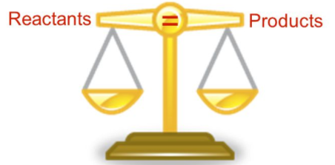
Yield and atom economy
Even though no atoms are gained or lost in a chemical reaction, it is not always possible to obtain the calculated amount of product because:
Incomplete reactions because they are reversible
Some of the product may be lost when it is separated from the reaction mixture
Some of the reactants may react in ways different to the expected reactions
The amount of product obtained is known as the yield.
The theoretical yield is the maximum calculated amount of a product that could be formed from a given amount of reactants.
The actual yield is the actual amount of product obtained from a chemical reaction.

Slide 32
Yield
When compared with the maximum theoretical amount as a percentage, it is called the percentage yield and is calculated as:
percentage yield = mass of product actually made x 100
maximum theoretical mass of product
A piece of sodium metal is heated in chlorine gas. A maximum theoretical mass of 10g for sodium chloride was calculated, but the actual yield was only 8g.
Calculate the percentage yield.
percentage yield = 8/10 x 100
= 80%
This means the percentage yield is 80%
HIGHER:
200g of calcium carbonate is heated. It decomposes to make calcium oxide and carbon dioxide. Calculate the theoretical mass of calcium oxide made.
CaCO₃ → CaO + CO₂
M_{r} of CaCO₃ = 40 + 12 + (16x3) = 100
M_{r} of CaO = 40 + 16 = 56
100g of CaCO₃ would make 56 g of CaO
So 200g would make 112g

Slide 33
Atom economy
The atom economy (atom utilisation) is a measure of the amount of starting materials that end up as useful products. It is important for sustainable development and for economic reasons to use reactions with high atom economy. The percentage atom economy is calculated using a balanced equation for the reaction as follows:
Relative formula mass of desired product from equation x 100
Sum of relative formula mass of all reactants from equation
Example:
Calculate the atom economy for making hydrogen by reacting zinc with hydrochloric acid:
Zn + 2HCl → ZnCl₂ + H₂
M_{r} of H₂ = 1 + 1 = 2
M_{r} of ZnCl₂ = 65 + 35.5 + 35.5 = 136
Atom economy = ²∕₁₃₆ ₊ ₂ × 100
= ²∕₁₃₈ × 100 = 1.45%
This method is unlikely to be chosen as it has a low atom economy.
The less waste there is, the higher the atom economy, the less materials are wasted, less energy used, so making the process more economic, 'greener' and sustainable.

Slide 34
QuestionIT!
Quantitative
Analysis – Part 2
Percentage yield
Atomy economy

Slide 35
Yield and atom economy (Chemistry only) – QuestionIT
What is meant by the term ‘yield’?
What is the equation for calculating percentage yield?
Give 2 reasons why it is not always possible to obtain the expected amount of product from a reaction.
What is meant by the term ‘atom economy’?
Why is it important to use reactions with high atom economy?
What is the equation for calculating the percentage atom economy from a balanced chemical equation?

Slide 36
Yield and atom economy (Chemistry only) – QuestionIT
Magnesium is heated in air to make magnesium oxide. Suggest why the actual yield might be less than the maximum theoretical yield.
In the neutralisation of sulfuric acid with sodium hydroxide, the theoretical yield from 13.8g of sulfuric acid is 20g. In a synthesis, the actual yield is 17.4g. What is the percentage yield for this synthesis?

Slide 37
Yield and atom economy (Chemistry only) – QuestionIT
Calculate the atom economy for making hydrogen from methane
and steam.
CH₄ + 2H₂O → CO₂ + 4H₂

Slide 38
AnswerIT!
Quantitative
Analysis – Part 2
Percentage yield
Atomy economy

Slide 39

Yield and atom economy (Chemistry only) – QuestionIT
What is meant by the term ‘yield’?
Amount of product obtained.
What is the equation for calculating percentage yield?
% yield = $\frac{mass of product actually made }{maximum theoretical mass of product}$ x 100
Give 2 reasons why it is not always possible to obtain the expected amount of product from a reaction.
Reaction may not go to completion as it is reversible; some product may be lost; some reactants may react differently to expected.
What is meant by the term ‘atom economy’?
Measure of the amount of starting materials that end up as useful products.

Slide 40
Yield and atom economy (Chemistry only) – QuestionIT
Why is it important to use reactions with high atom economy?
Sustainable development; less waste products produced; economically viable; cheaper.
What is the equation for calculating the percentage atom economy from a balanced chemical equation?
Atom economy = $\frac{RFM of desired product}{Sum of RFM of all reactants}$ x 100

Slide 41
Yield and atom economy (Chemistry only) – QuestionIT
Magnesium is heated in air to make magnesium oxide. Suggest why the actual yield might be less than the maximum theoretical mass.
Magnesium nitride is formed as well as the magnesium oxide
expected/some of the oxide might escape as smoke/not all the
magnesium reacts.
In the neutralisation of sulfuric acid with sodium hydroxide, the theoretical mass from 13.8g of sodium sulfate is 20g. In a synthesis, the actual yield is 17.4g. What is the percentage yield for this synthesis?
Percentage yield = (actual yield ÷ theoretical mass) × 100
Percentage yield = (17.4 ÷ 20) x 100 = 87%

Slide 42
Yield and atom economy (Chemistry only) – QuestionIT
Calculate the atom economy for making hydrogen from methane
and steam.
CH₄ + 2H₂O → CO₂ + 4H₂
M_{r} of H₂O = (1 x 2) + 16 = 18
18 x 2 = 36
M_{r} of CH₄ = 12 + (1 x 4) = 16
Atom economy = ^{4 × 2}∕₃₆ ₊ ₁₆ × 100
= ⁸∕₅₂ × 100 = 15.4%

Slide 43
LearnIT!
KnowIT!
Quantitative
Analysis – Part 3
Molar volume of gas (HT)

Slide 44
Molar volume of gas (HT)
Equal amounts of moles or gases occupy the same volume under the same conditions of temperature and pressure.
The volume of one mole of any gas at room temperature and pressure (rtp) (20°C and 1 atmospheric pressure) is 24 dm³.
You can calculate the volume of a gas at room temperature and pressure from its mass and relative formula mass using the equation:
Number of moles = mass
relative formula mass
Volume of gas at rtp = moles x 24
You can calculate the volumes of gaseous reactants and products from a balanced equation and a given volume of a gaseous reactant or product using the following equation:
Volume of gas at rtp = number of moles x molar mass
volume (24 dm³)

Slide 45
Molar volume of gas (HT)
What is the volume of 3.5g of hydrogen?
A_{r} : H (1)
M_{r} : H₂ = 2
1 mole in g = 2g
3.5/2 = 1.75 mol
volume H₂ = 1.75 x 24 = 42 dm³
6g of a hydrocarbon gas had a volume of 4.8 dm³. Calculate its molecular mass.
1 mole = 24 dm³, so 4.8/24 = 0.2 mol
M_{r} = 6 / 0.2 = 30
if 6g = 0.2 mol, 1 mol equals 30 g
What mass of magnesium carbonate is needed to make 6 dm³ of carbon dioxide?
MgCO_{3(s)} + H₂SO_{4(aq)} → MgSO_{4(aq)} + H₂O_{(l)} +CO_{2(g)}
1 mole = 24 dm³, 6 dm³ is equal to 6/24 = 0.25 mol of gas
From the equation, 1 mole of MgCO₃ produces 1 mole of CO₂, which occupies a volume of 24 dm³.
so 0.25 moles of MgCO₃ is needed to make 0.25 mol of CO₂
M_{r} : MgCO₃ = 24 + 12 + (3 x 16) = 84,
Mass of MgCO₃ = 0.25 x 84 = 21g
What is the volume of 11.6 g of
butane (C₄H₁₀) gas at RTP?
M_{r} : (4 x 12) + (10 x 1) = 58
11.6/58 = 0.20 mol
volume = 0.20 x 24 = 4.8 dm³

Slide 46
QuestionIT!
Quantitative
Analysis – Part 3
Molar volume of gas (HT)

Slide 47
Quantities (Chemistry only) – QuestionIT
What can be said about equal amounts of moles of gases and the volume they occupy?
What is meant by RTP?
What are the values for RTP?
What is the volume of 4.5g of oxygen?
Calculate the number of moles of hydrogen that occupy 6dm³ at RTP.

Slide 48
AnswerIT!
Quantitative
Analysis – Part 3
Molar volume of gas (HT)

Slide 49
Quantities (Chemistry only) – QuestionIT
What can be said about equal amounts of moles of gases and the volume they occupy?
Equal amounts of moles of gases occupy the same volume under the same conditions of temperature and pressure.
What is meant by RTP?
Room temperature and pressure
What are the values for RTP?
0ºC ; 1 atmosphere pressure

Slide 50
Quantities (Chemistry only) – QuestionIT
What is the volume of 4.5g of oxygen?
A_{r} : O (16)
M_{r} : O₂ = 32
1 mole in g = 32g
4.5/32 = 0.14 mol
Volume O₂ = 0.14 x 24 = 3.38 dm³
Calculate the number of moles of hydrogen that occupy 6dm³ at
RTP.
Number of moles = 6 ÷ 24 = 0.25 mol

Slide 51
LearnIT!
KnowIT!
Dynamic equilibria –
Haber process
Factors affecting rate of attainment of equilibria (HT)
Fertilisers

Slide 52
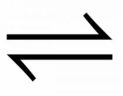
The Haber process (HT)
The production of ammonia is a reversible reaction that can reach a dynamic equilibrium:
3H₂ + N₂ 2NH₃
Several factors affect the rate of attainment of equilibrium such as this. They include:
Changes in temperature
Changes in pressure
Changes in concentration
Use of catalyst
When manufacturing ammonia using the Haber process the conditions actually used in industry may differ from theoretical ideals. This will be influenced by the availability and cost of raw materials and energy supplies; the control of temperature, pressure and catalyst used; as well as achieving an acceptable yield in an acceptable time.

Slide 53
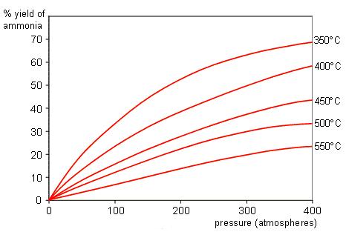
The Haber process – industrial compromise (HT)
The ideal conditions for the production of ammonia in terms of dynamic equilibrium are:
Low temperature – because the forward reaction is exothermic. Low temperatures mean a slow rate of reaction. Higher temperatures have a faster rate of reaction, but produce a lower yield – (see graph)
High pressure – because there are fewer moles of gas on the ammonia side of the equation. High pressures require very strong and expensive equipment increasing the cost of production.
High concentration of reactants – so more product is formed. The reactants are expensive and are recycled. Removing the product has the same impact.
Catalyst is added to speed up the rate of reaction - in both directions!

Slide 54
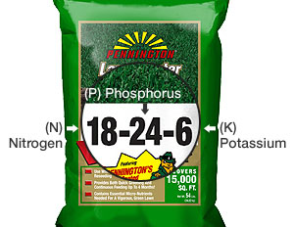
Fertilisers
Many fertilisers contain nitrogen, phosphorus and potassium to promote plant growth. They are therefore known as NPK fertilisers. Ammonium nitrate is a salt used as a fertiliser, produced from the reaction between ammonia and nitric acid.
NH₃ + HNO₃ → NH₄NO₃
Preparation of ammonium sulfate from ammonia solution and dilute sulfuric acid.
Add known volume of dilute sulfuric acid to an evaporating basin.
Add known volume and concentration of ammonia to the sulfuric acid.
Test with universal indicator paper to ensure neutral.
Evaporate the solution slowly using Bunsen burner to concentrate the solution.
Cool until crystals form; dry the sample.
In industry, the quantities of raw materials required mean the preparation of ammonia using the Haber process, and sulfuric acid using the Contact process. The reaction is carried out on a much larger scale.
2NH₃ + H₂SO₄ → (NH₄)₂SO₄

Slide 55
QuestionIT!
Dynamic equilibria –
Haber process
Factors affecting rate of attainment of equilibria (HT)
Fertilisers

Slide 56
Dynamic equilibria QuestionIT
What is a reversible reaction?
Give the balanced symbol equation for the reaction between nitrogen and hydrogen to produce ammonia.
(HT) What compromises are made in the reaction conditions for the production of ammonia in the Haber process?
What three elements do most fertilisers contain?
What is produced when ammonia reacts with nitric acid?

Slide 57
Dynamic equilibria QuestionIT
Write a balanced symbol equation for the reaction between ammonia and nitric acid.
Write a balanced symbol equation for the reaction between ammonia and sulfuric acid.

Slide 58
AnswerIT!
Dynamic equilibria –
Haber process
Factors affecting rate of attainment of equilibria (HT)
Fertilisers

Slide 59
Dynamic equilibria QuestionIT
What is a reversible reaction?
Chemical reaction which can go in either direction.
Give the balanced symbol equation for the reaction between nitrogen and hydrogen to produce ammonia.
2H₂ + N₂ → 2NH₃
(HT) What compromises are made in the reaction conditions for the production of ammonia in the Haber process?
Slightly higher temperature – to increase rate of reaction; slightly lower pressure – to reduce costs and increase safety.
What three elements do most fertilisers contain?
Nitrogen, phosphorus, potassium.
What is produced when ammonia reacts with nitric acid?
Salt; ammonium nitrate

Slide 60
Dynamic equilibria QuestionIT
Write a balanced symbol equation for the reaction between ammonia and nitric acid.
NH₃ + HNO₃ → NH₄NO₃
Write a balanced symbol equation for the reaction between ammonia and sulfuric acid.
2NH₃ + H₂SO₄ → (NH₄)₂SO₄

Slide 61
LearnIT!
KnowIT!
Chemical Cells And
Fuel Cells
Cells
Fuel Cells

Slide 62
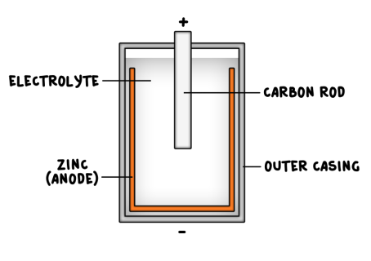
Cells
Cells contain chemicals which react to produce electricity. They continue to produce a voltage until one of the reactants is used up.
The voltage produced by a cell is dependent upon a number of factors including the type of electrode and electrolyte.
A simple cell can be made by connecting two different metals in contact with an electrolyte.

Slide 63
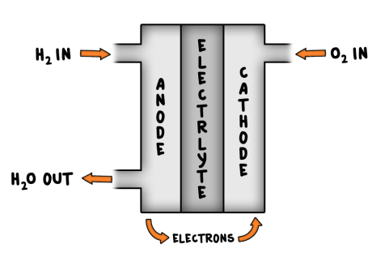
Hydrogen – oxygen fuel cells
Fuel cells are supplied by an external source of fuel (e.g. hydrogen) and oxygen or air. The fuel is oxidised electrochemically within the fuel cell to produce a potential difference (a voltage).
The overall reaction in a hydrogen fuel cell involves the oxidation of hydrogen to produce water.
hydrogen + oxygen → water
2H₂ (g) + O₂ (g)→ 2H₂O (g)
Hydrogen fuel cells offer a potential alternative to rechargeable cells and batteries.

Slide 64
QuestionIT!
Chemical Cells And
Fuel Cells
Cells
Fuel Cells

Slide 65
Chemical and fuel cells QuestionIT
Give two factors which may affect the voltage given out by a battery.
Here is a reactivity series of metals. The most reactive is first, the least reactive is last: Magnesium Zinc Tin Copper
Which two metals would you use to make a battery which had the highest voltage? Explain why.
Why do non-renewable batteries stop producing a voltage after a certain time?
How are rechargeable batteries recharged?

Slide 66
Chemical and fuel cells QuestionIT
What chemical is the fuel in a fuel cell ?
What happens to this fuel inside the fuel cell to produce a potential difference?
Write the overall balanced symbol equation for the reaction in a fuel cell.

Slide 67
AnswerIT!
Chemical Cells And
Fuel Cells
Cells
Fuel Cells

Slide 68
Chemical and fuel cells AnswerIT
Give two factors which may affect the voltage given out by a battery.
The type of electrode and the electrolyte
Here is a reactivity series of metals. The most reactive is first, the least reactive is last. Magnesium Zinc Tin Copper
Which two metals would you use to make a battery which gave off the most voltage? Explain why
Magnesium and copper as largest difference in reactivity.
Why do non-renewable batteries stop producing a voltage after a certain time?
The chemical reactions stop when one of the reactants has been used up.
How are rechargeable batteries recharged?
The chemical reactions are reversed by an external electrical current.

Slide 69
Chemical and fuel cells AnswerIT
What chemical is the fuel in a fuel cell ?
Hydrogen.
What happens to this fuel inside the fuel cell to produce a potential difference?
It is oxidised.
Write the overall balanced symbol equation for the reaction in a fuel cell.
2H₂ (g) + O₂ (g)→ 2H₂O (g)

